Slide 1


DESIGN AND IMPLEMENTATION OF A MOBILE APP FOR COLLECTION OF USER EXPERIENCE DATA FROM MOBILE NETWORK SUBSCRIBERS
GROUP 5
TASK 5

Slide 2
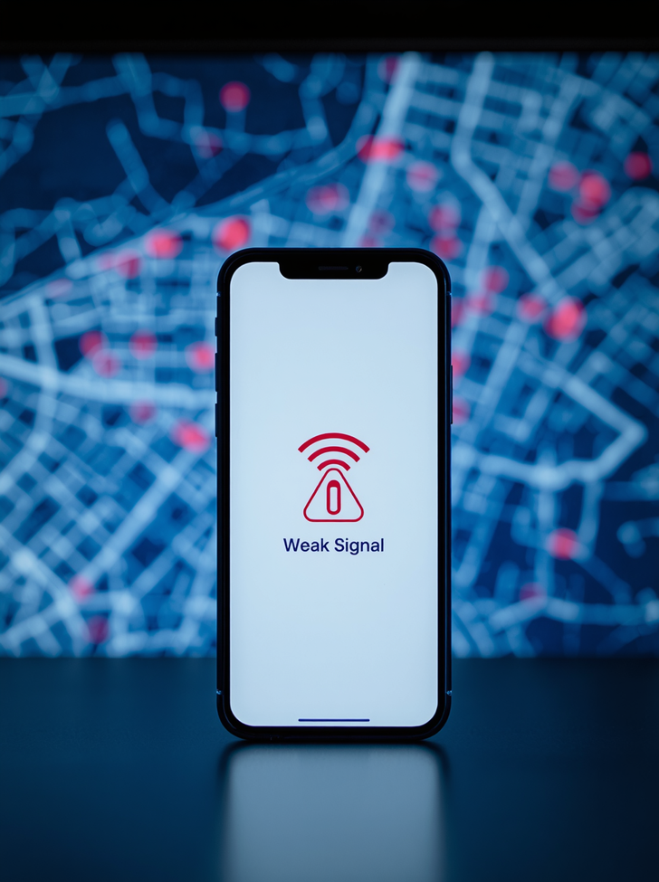
PROBLEM STATEMENT
• Lack of user-centered network data: Traditional monitoring fails to capture real subscriber experience.
• Limited geographical visibility: Network quality issues are not mapped across coverage areas.
• Difficulty identifying dead zones: Poor network zones remain undetected without crowd-sourced data.
• Inadequate integration of QoS & QoE: Technical metrics and user experience data are rarely combined for accurate assessment.

Slide 3
Measure QoS Metrics
Collect key network quality indicators including latency, jitter, packet loss, and download/upload speeds from subscriber devices in real time.
PROJECT OBJECTIVES
Collect QoE Ratings & Store Data
Gather subjective user experience ratings on signal stability, browsing, and streaming. Store data locally via SQLite and sync to MongoDB cloud when online.
General Objective: Develop a mobile application to collect, store, and analyze user experience data from mobile network subscribers, providing accurate QoS and QoE insights for network performance assessment.
Visualize & Monitor Network Quality
Visualize collected data geographically using heatmaps to identify poor network zones. Provide administrators with monitoring tools for advanced analysis and filtering.

Slide 4
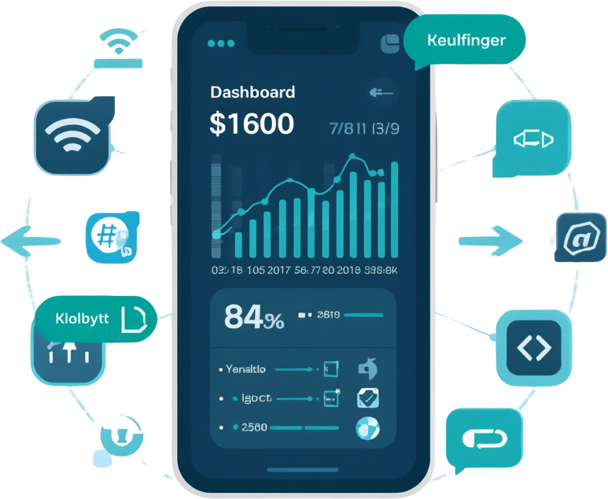
WHY WE CHOSE THE NAME KILOBYTES
The name KiloBytes was carefully selected to reflect the core identity of our application:
• Directly associated with digital communication and data transfer
• Professional, technology-oriented, and easy to remember
• Conveys precision in measuring network performance metrics
• Suitable for standalone product deployment across platforms

Slide 5
DESIGN METHODOLOGY
Phase 1
Phase 2
Phase 3
Phase 4
Requirements Analysis
Gathering functional and non-functional requirements from stakeholders and mobile network subscribers to define app scope.
Wireframing & Prototype Design
Creating low-fidelity wireframes and high-fidelity Figma prototypes to plan UI/UX before development begins.
Implementation & Evaluation
Coding the frontend with React Native and backend with Node.js, followed by iterative evaluation and user feedback.
Testing & Deployment
Rigorous testing of features including measurement engine, offline sync, heatmap, and cross-platform deployment.

Slide 6
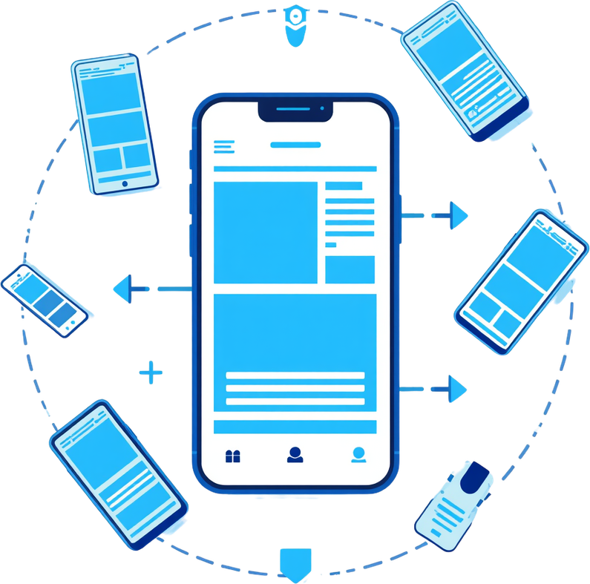

FIGMA DESIGN PROCESS
Our UI/UX design followed a structured process:
• Initial Wireframes: Low-fidelity sketches outlining core screens and layout structure
• User Flow Design: Mapping navigation paths between app screens for intuitive interaction
• Layout Planning: Defining spacing, grid systems, and component placement
• High-Fidelity Prototypes: Detailed, interactive mockups reflecting final visual design
• Design Review: Thorough evaluation and feedback cycles before development handoff

Slide 7
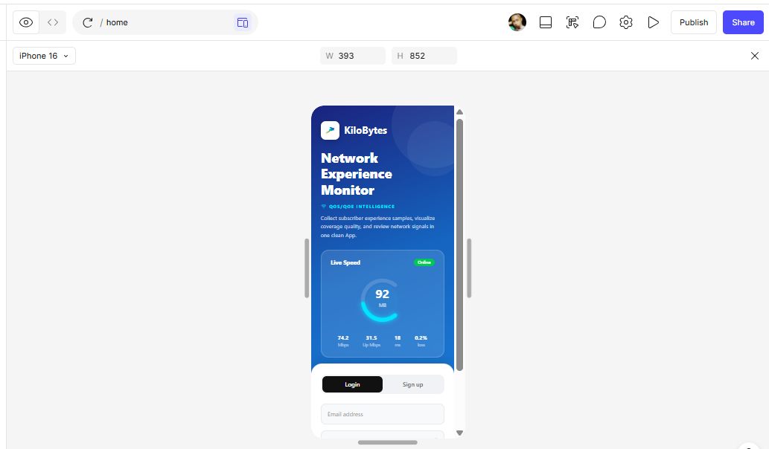

Slide 8
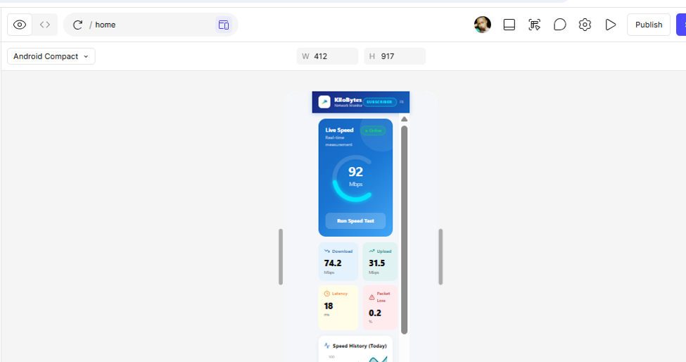

Slide 9
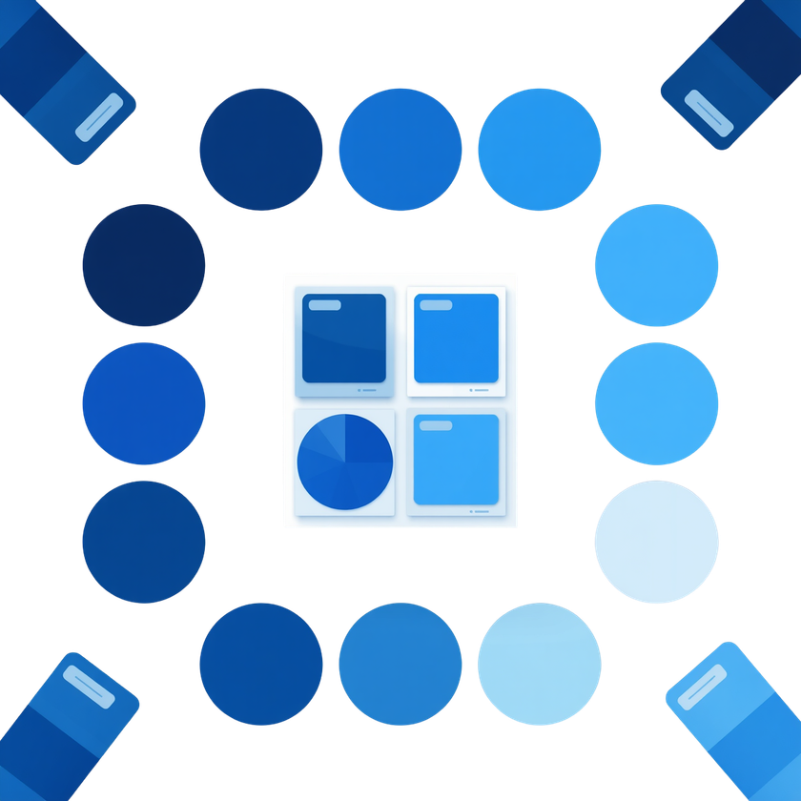
WHY BLUE?
THE COLOR OF TRUST & TECHNOLOGY
Blue was selected as the primary color for KiloBytes because it universally conveys trust, reliability, and professionalism , core values for a network monitoring application.
Blue is strongly associated with technology, communication, and digital innovation, making it ideal for an app focused on mobile network performance. It promotes a calm, focused user experience while reinforcing confidence in the data presented.

Slide 10
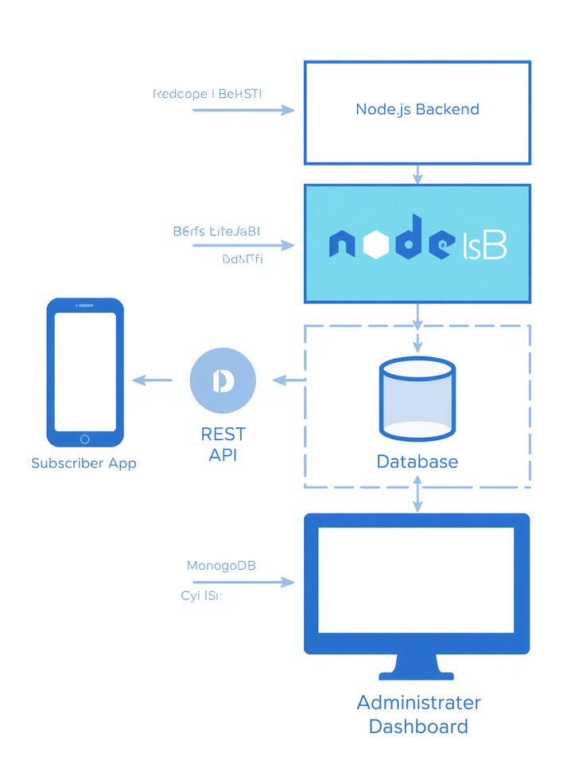
SYSTEM ARCHITECTURE
The KiloBytes system is built on a layered architecture with five core components:
• Subscriber App – React Native mobile client for data collection
• REST API – Handles communication between app and backend
• Node.js Backend – Processes requests and business logic
• MongoDB Database – Cloud storage for all network measurements
• Administrator Dashboard – Web interface for monitoring and analysis
Data flows from the mobile app through the REST API to the Node.js backend, where it is persisted in MongoDB and made available to the admin dashboard for analysis.

Slide 11
TECHNOLOGY STACK
Tools
Frontend
Database
Backend
Figma – UI/UX wireframing and prototyping
GitHub – Version control and collaboration
Expo Location – GPS and geolocation services
React Native – Cross-platform mobile development
Expo – Build and deployment toolchain
React Navigation – Screen and tab navigation
React Hooks – State and lifecycle management
MongoDB – Cloud-based data storage and sync
SQLite – Local offline storage on device
Async data sync between local and cloud
Node.js – Server-side JavaScript runtime
Express.js – RESTful API framework
MongoDB – Cloud NoSQL database
REST API – Client-server communication

Slide 12
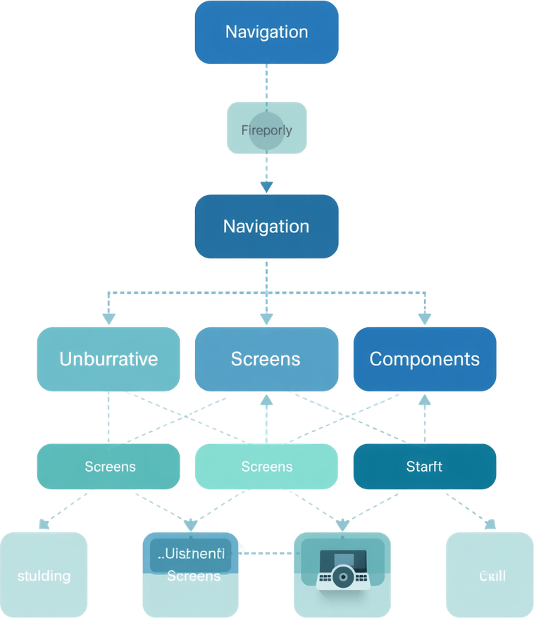
FRONTEND IMPLEMENTATION
• Component-Based Architecture: Modular, reusable UI components for scalability and maintainability across the app.
• React Navigation: Multi-screen navigation system with stack and tab navigators for seamless user flow.
• State Management: React Hooks (useState, useEffect) manage local and shared application state efficiently.
• API Integration: Axios-based service layer handles RESTful communication with the Node.js backend securely.

Slide 13
Network Measurement Engine
Automatically measures key QoS metrics including latency, jitter, packet loss, and download/upload speeds in real time.
TECHNICAL FEATURES OVERVIEW
QoE Data Collection
Allows subscribers to rate their subjective experience — signal stability, browsing performance, and streaming quality — combining user feedback with technical data.
The KiloBytes application is built around five core technical pillars, each designed to deliver accurate, reliable, and user-friendly network experience data collection. Together, these features form a comprehensive mobile platform for QoS and QoE monitoring.
Offline Storage & Sync, Heatmap Visualization, and Security & Authentication — ensuring data persistence, geographic insights, and secure multi-role access across the platform.

Slide 14
4 KEY
METRICS
NETWORK MEASUREMENT ENGINE: METRICS MEASURED
Latency: Measures the average response time (in ms) for data packets to travel from the device to the server and back. Jitter: Captures variation in latency over successive measurements, indicating network stability. Packet Loss: Calculates the percentage of failed or dropped requests during a test session. Download & Upload Speed: Records throughput in Mbps to assess real-world data transfer performance for subscribers.

Slide 15

LOCATION COLLECTION
GPS coordinates and accuracy are collected in real-time during each measurement session. Reverse geocoding is applied to identify the subscriber's city and country from raw coordinates. This geographic data enables the generation of network quality heatmaps and supports detailed geographic analysis of mobile network performance across regions.

Slide 16
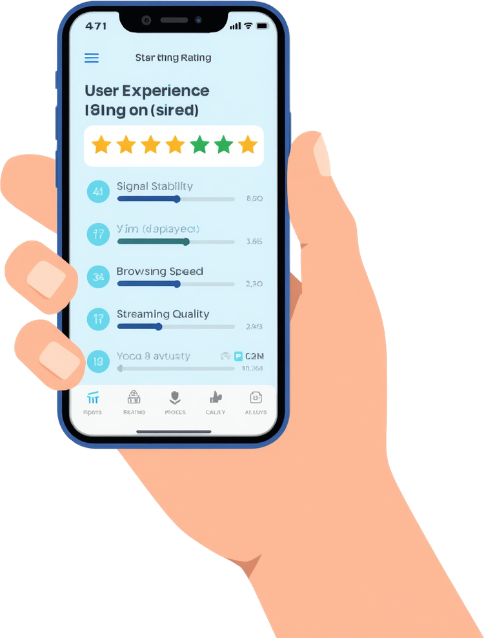
QOE DATA COLLECTION
Subscribers rate their network experience across key dimensions including signal stability, browsing performance, and streaming quality. The KiloBytes app presents an intuitive QoE form after each measurement session, combining objective technical metrics with subjective user feedback to deliver a comprehensive view of real-world network performance.

Slide 17
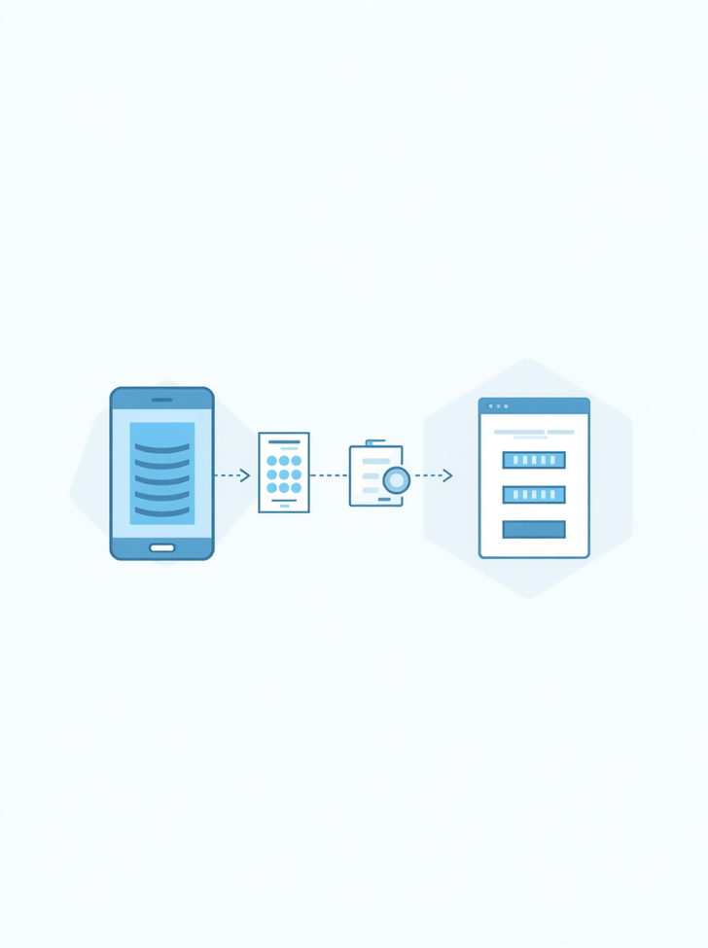
OFFLINE STORAGE AND SYNCHRONIZATION
KiloBytes uses SQLite for local on-device storage, ensuring measurements are saved even without internet connectivity. Once a connection is restored, data automatically synchronizes with the MongoDB cloud database — guaranteeing no data loss and seamless continuity between offline and online states.

Slide 18

AUTHENTICATION AND SECURITY
The KiloBytes app implements a robust login system that secures access for all users. Authentication is required before any data collection or dashboard interaction begins.
• Login System: Credentials verified before granting access to app features
• User Roles: Two distinct roles — Subscriber (data collection) and Administrator (monitoring & analysis)
• Secure Communication: Encrypted data exchange between the mobile app and the Node.js backend via REST API
• Session Management: Tokens used to maintain secure, authenticated sessions throughout app use

Slide 19
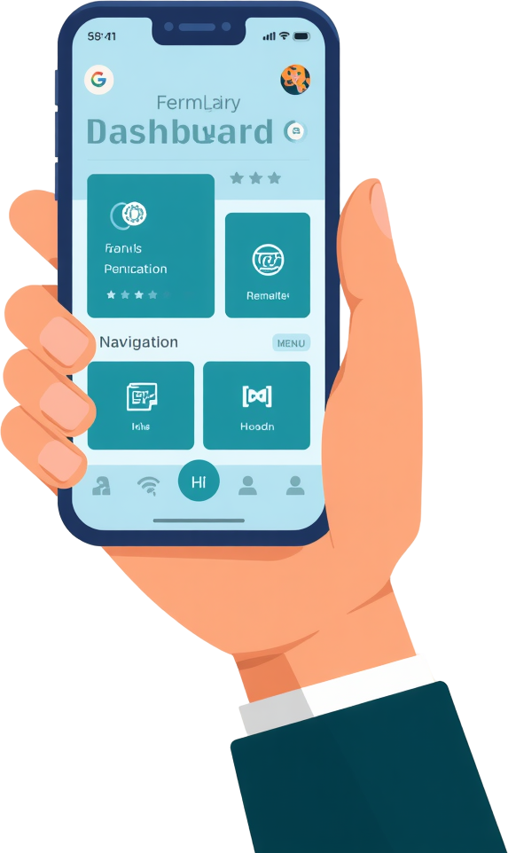
HOME DASHBOARD
The central hub of the KiloBytes app provides seamless access to all core features:
• Start Measurement – Initiate real-time QoS/QoE data collection
• View History – Browse past measurement records and trends
• Access Heatmap – Explore geographic network quality visualization
• Settings – Manage account preferences and sync options

Slide 20
User Initiates Test: The subscriber taps the "Start Measurement" button on the home dashboard to begin the network performance test session.
MEASUREMENT INTERFACE
Real-Time Metrics Collection: Latency, jitter, packet loss, download and upload speeds are measured live and displayed dynamically on screen as the test runs.
The measurement interface guides subscribers through a seamless testing process. Real-time metrics are collected and displayed instantly, followed by a QoE feedback form to capture subjective user experience alongside technical data.
Results & QoE Form: Calculated results are presented to the user, followed by the QoE rating form where subscribers evaluate signal stability, browsing, and streaming quality.

Slide 21
REAL-TIME
SPEEDOMETER: INSTANT VISUAL FEEDBACK
The KiloBytes app features an animated speedometer gauge that displays download and upload speeds in real time during network tests. As the measurement runs, the gauge needle sweeps dynamically to reflect current speed values, giving users immediate, intuitive feedback on their network performance. The visual design uses color-coded zones — green for fast speeds, orange for moderate, and red for slow — making results easy to interpret at a glance. This real-time display enhances user engagement and ensures transparency throughout the measurement process.

Slide 22

HISTORICAL RECORDS
KiloBytes stores all past measurements locally and syncs them to the cloud, allowing users to review their complete network history at any time.
• View past download and upload speeds
• Track latency, jitter, and packet loss over time
• Access location, date, and time for each record
• Identify personal usage trends and patterns
• Supports informed decisions through personal data analysis

Slide 23

HEATMAP OVERVIEW
The KiloBytes heatmap converts collected network data into a color-coded geographic visualization, providing instant insights into network quality across different locations.
• Color-coded markers highlight network performance zones
• Identifies poor network areas and dead zones at a glance
• Enables comparison of network quality across regions
• Helps subscribers and admins make data-driven decisions
• Interactive map interface for seamless exploration

Slide 24
Marker Colors: Green indicates Good network quality, Orange indicates Moderate performance, and Red indicates Poor connectivity. Colors are assigned based on computed latency and speed thresholds from collected measurements.
HEATMAP TECHNICAL DESIGN
Density Circles: Each marker displays a surrounding radius circle whose size scales proportionally with measured latency. Higher latency produces a larger circle, visually emphasizing areas with degraded network response times.
The heatmap uses a color-coded marker system to represent network quality visually. Each marker reflects real measured data collected from subscribers, enabling intuitive geographic analysis of network performance across different locations and zones.
Interactive Markers: Tapping any marker on the heatmap reveals detailed measurement information including latency, download speed, upload speed, packet loss, QoE rating, date, and the subscriber's location at time of measurement.

Slide 25

ADMINISTRATIVE DASHBOARD
The admin dashboard provides network administrators with comprehensive monitoring tools. Administrators can view all registered subscribers and their collected measurement data, analyze network quality across different geographic locations and user segments, and apply advanced filtering options to drill down into specific metrics. This centralized control panel enables data-driven decisions for improving mobile network performance and subscriber experience.

Slide 26
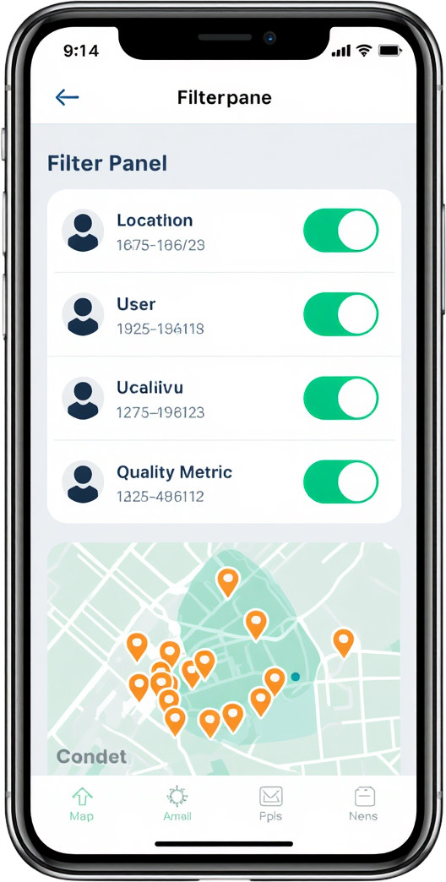
ADVANCED FILTERING
The KiloBytes admin dashboard features powerful filtering tools for in-depth network analysis:
• Filter by Location: Narrow results to specific cities or regions for targeted insights.
• Filter by User: Isolate individual subscriber data for personalized analysis.
• Filter by Quality Metrics: Sort by latency, speed, packet loss, or QoE ratings.
• Automatic Map Focus: The heatmap auto-zooms to the filtered area for instant geographic context.
• Supports detailed network analysis, enabling administrators to identify problem zones efficiently.

Slide 27
Successful collection of both QoS metrics (latency, jitter, packet loss, download/upload speed) and QoE subjective ratings directly from mobile network subscribers.
KEY ACHIEVEMENTS
Offline storage support implemented using SQLite, with automatic synchronization to MongoDB cloud database when internet connectivity is restored.
The KiloBytes application successfully delivered on all major project goals, demonstrating strong technical execution and practical deployment of mobile network data collection and visualization capabilities.
Heatmap visualization and administrative dashboard fully completed, enabling geographic network quality analysis and cross-platform deployment on both iOS and Android.

Slide 28
GPS Inconsistencies: Inaccurate or fluctuating GPS signals affected the precision of location data collected during network measurements, impacting heatmap reliability.
CHALLENGES ENCOUNTERED
Network Fluctuations: Unstable network conditions during test execution led to inconsistent measurement results, making it difficult to ensure data accuracy and repeatability.
Throughout the development of the KiloBytes application, several significant challenges were encountered:
• Mobile Performance Optimization: Ensuring smooth UX while running intensive network measurements required careful resource management and performance tuning.
• Visualization of Large Datasets: Rendering large volumes of measurement data on mobile heatmaps demanded efficient data handling and rendering strategies.
Synchronization Issues: Managing reliable data sync between local SQLite storage and the MongoDB cloud database posed challenges, especially under intermittent connectivity conditions.

Slide 29
Importance of prototyping and iterative design: Early wireframing in Figma allowed us to identify usability issues before coding, saving significant development time and improving the final UI quality.
LESSONS LEARNED
Value of user feedback for usability improvements: Incorporating user feedback during testing revealed real-world usage patterns and helped refine the QoE rating interface and navigation flow.
Reflecting on the KiloBytes project, our team gained valuable insights across multiple dimensions of mobile app development — from design methodology to technical implementation and data management.
Mobile app architecture, geospatial visualization, and data synchronization: We deepened our understanding of component-based architecture, GPS-based heatmap rendering, and reliable offline-to-cloud sync strategies.

Slide 30
Machine Learning for Network Quality Predictions: Integrate ML models to predict network degradation, identify patterns, and proactively alert users and administrators about potential issues.
FUTURE IMPROVEMENTS
Real-Time Network Monitoring & Advanced Analytics: Enable live network monitoring with detailed reporting dashboards, comparative analysis between network providers, and trend-based insights.
The KiloBytes application has significant potential for growth. Planned enhancements include machine learning-based predictions, real-time monitoring, advanced analytics, comparative provider reports, and push notifications to deliver a more powerful and user-friendly network assessment platform.
Push Notifications & User Alerts: Implement intelligent push notifications to inform subscribers of network quality changes, measurement reminders, and personalized performance summaries.

Slide 31

CONCLUSION
KiloBytes delivers a comprehensive platform for collecting and visualizing QoS and QoE data directly from mobile network subscribers. By combining objective technical metrics with subjective user experience ratings, it provides richer and more accurate network performance insights. The application demonstrates the potential of mobile technology in network performance assessment and encourages data-driven decision making in the telecommunications sector.

Slide 32
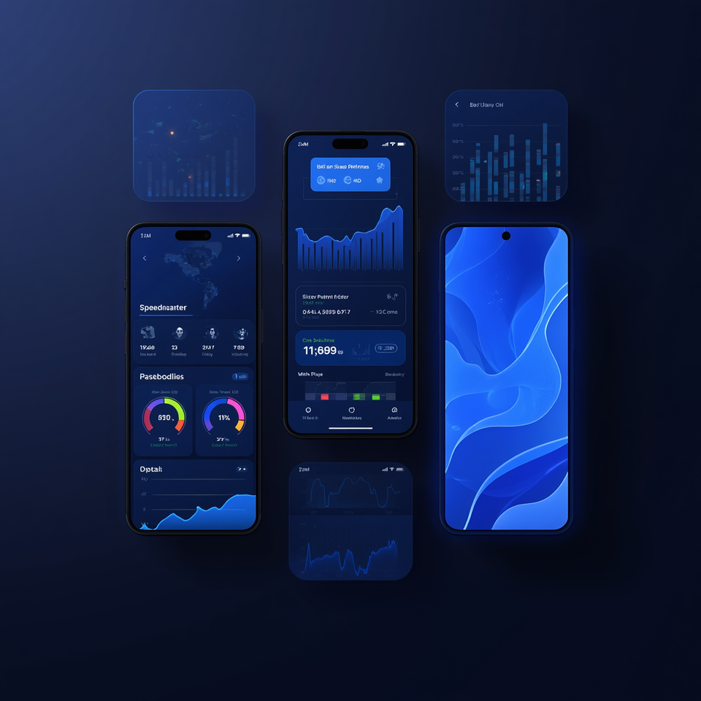
APPLICATION SHOWCASE
A visual gallery of the KiloBytes application screens, highlighting the intuitive blue-themed UI design and core features:
• Home Dashboard — Start measurements, view history, access heatmap
• Speedometer — Animated real-time download/upload speed gauge
• QoE Rating Screen — User experience feedback interface
• Heatmap — Geographic network quality visualization
• Administrator Dashboard — Subscriber data monitoring and filtering
Clean, modern, and cross-platform design built with React Native and Expo.

Slide 33

KILOBYTES – MOBILE NETWORK USER EXPERIENCE APP | CEF440
THANK YOU!
QUESTIONS?
UNIVERSITY OF BUEA – FACULTY OF ENGINEERING & TECHNOLOGY

